Slide 1
AI-Powered Business & Market Intelligence Agent
DS Intern Hackathon – May 2026
Technologies Used:
Python, Streamlit, Groq LLM, DDGS, BeautifulSoup
Developed By:
Khushi Kumari

Slide 2
Problem Statement
Business Challenge
Competitor research is time-consuming.
Market information is scattered across websites, blogs, and news sources.
Product positioning and marketing analysis require significant manual effort.
Businesses need faster access to actionable market intelligence.
Goal:
Build an AI-powered system that converts public web information into business intelligence.

Slide 3
Solution Overview
AI-Powered Business & Market Intelligence Agent
The system:
Collects public web information
Extracts relevant content
Removes duplicate sources
Performs AI-powered analysis
Generates structured business reports
Tracks Supported
Competitor Intelligence
Product Marketing Intelligence
Complete Business & Market Intelligence

Slide 4

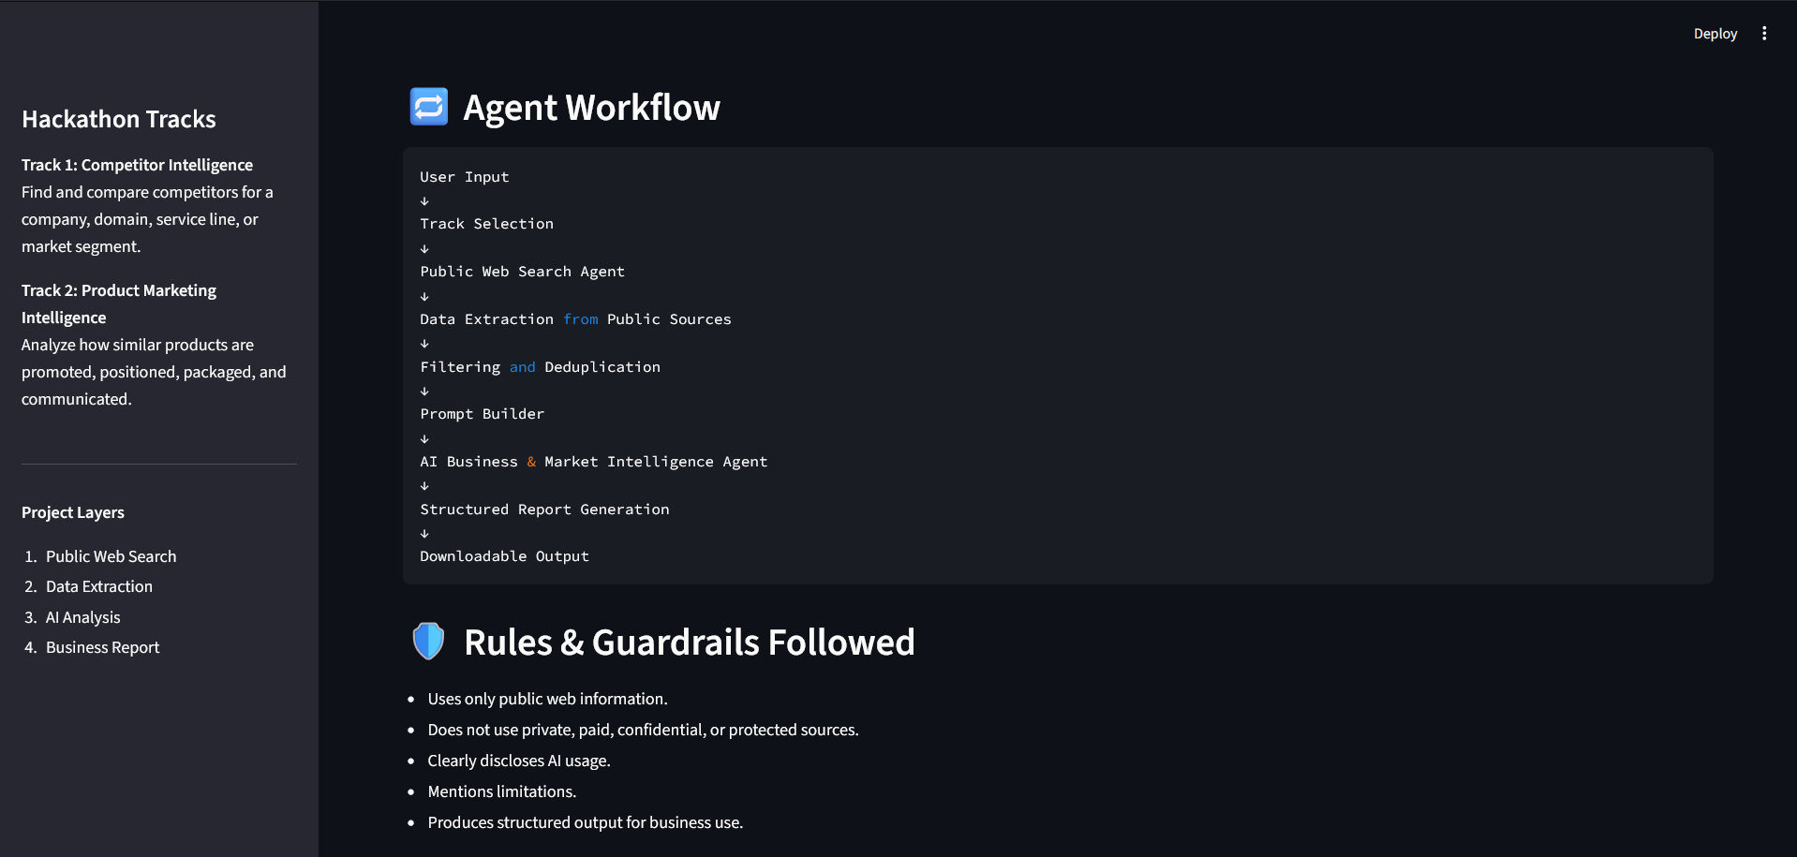
System Architecture
User Input
↓
Track Selection
↓
Public Web Search
↓
Data Collection
↓
Content Extraction
↓
Filtering & Deduplication
↓
AI Analysis (Groq LLM)
↓
Report Generation
↓
Downloadable Output

Slide 5
Features Implemented
Competitor Intelligence
Competitor Discovery
Competitor Ranking
Comparison Table
Market Gap Analysis
Opportunity Identification
Product Marketing Intelligence
Product Ranking
Product Positioning Analysis
Marketing Messaging Analysis
Market Trends
Recommendations

Slide 6
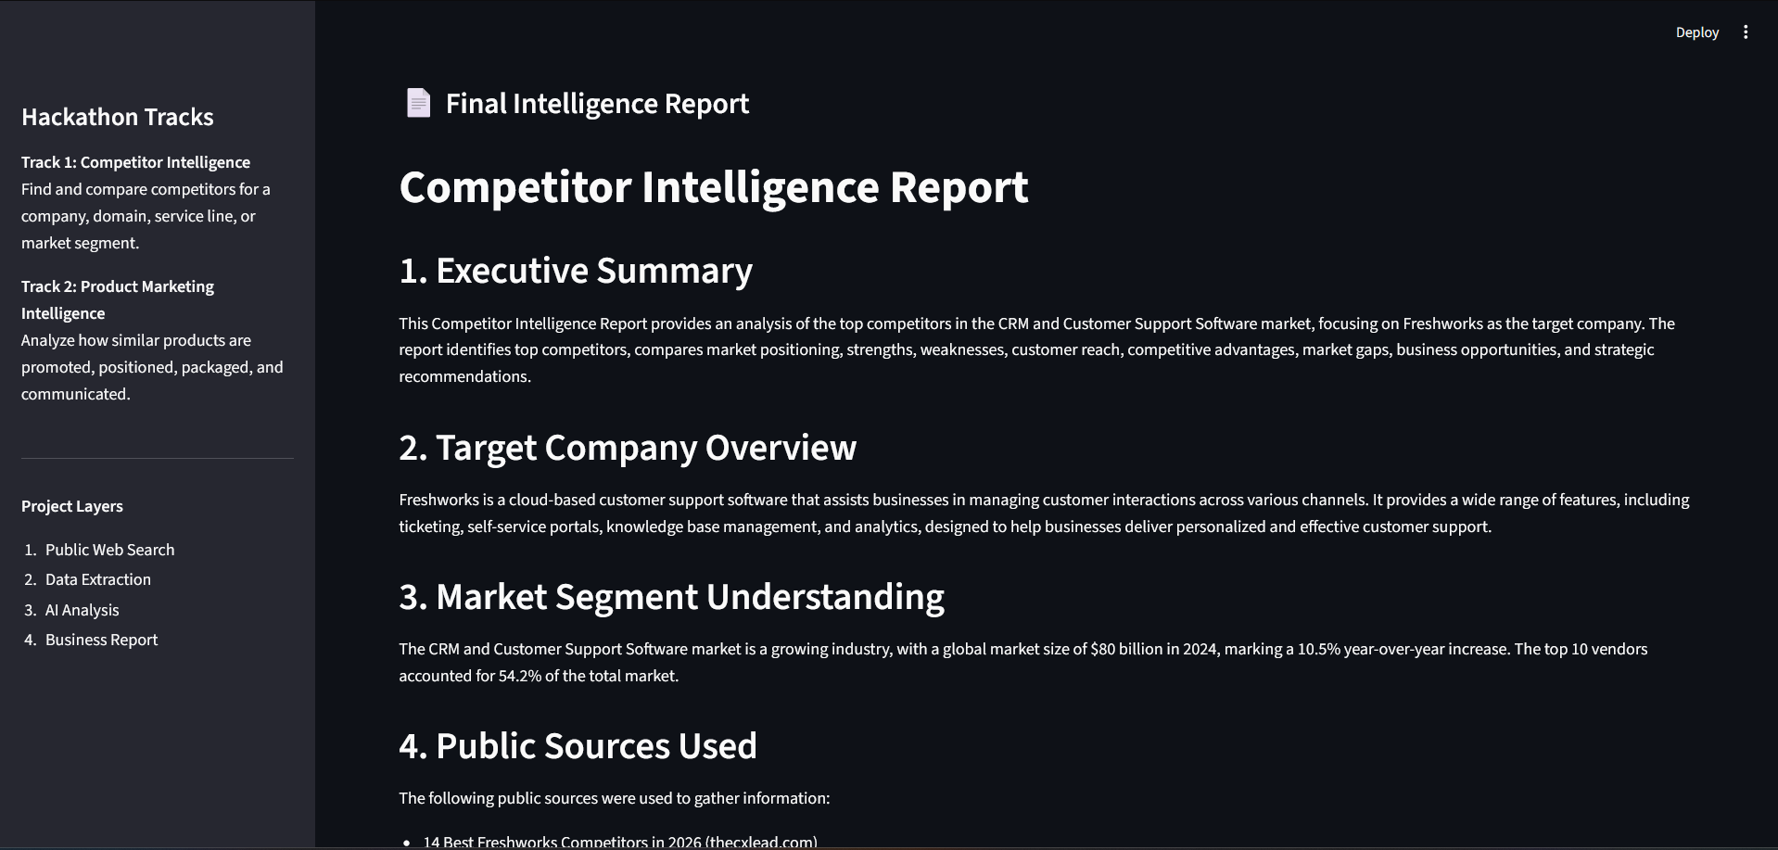
Results & Sample Output
Outputs Generated
Executive Summary
Competitor Ranking
Product Ranking
SWOT Analysis
Market Trends
Opportunities & Risks
Strategic Recommendations
AI Usage Disclosure
Sample Companies Tested
Freshworks
ChatGPT
Zomato

Slide 7
Conclusion
Project Outcome
Successfully implemented both hackathon tracks.
Automated competitor and market research.
Uses public web data and AI-powered analysis.
Generates business-readable reports with actionable insights.
Future Improvements
Social Media Monitoring
RSS Feed Integration
PDF Report Generation
Interactive Dashboards
Multi-Agent Architecture

Slide 8
Thank You

